Slide 1
Digital Image Processing
Image Restoration: Noise Removal

Slide 2
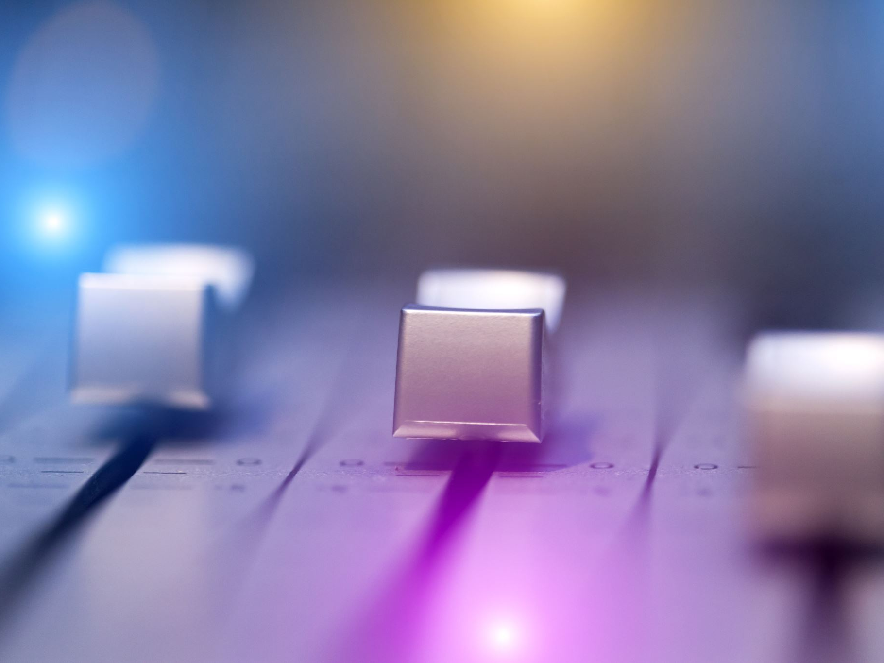
Contents
In this lecture we will look at image restoration techniques used for noise removal
Image restoration
Noise and images
Noise models
Noise removal using spatial domain filtering
Periodic noise
Noise removal using frequency domain filtering

Slide 3
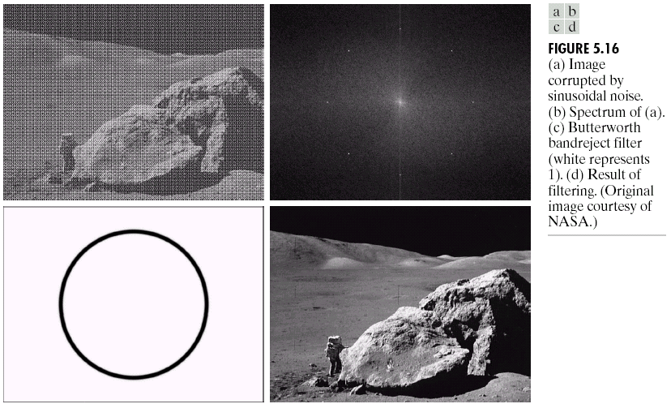
Image Restoration
Image restoration attempts to restore images that have been degraded
Identify the degradation process and attempt to reverse it
Similar to image enhancement, but more objective

Slide 4
Image Restoration
Goal of image restoration
Improve an image in some predefined sense
Difference with image enhancement ?
Features
Image restoration v.s image enhancement
Objective process v.s. subjective process
A prior knowledge v.s heuristic process
A prior knowledge of the degradation phenomenon is considered
Modeling the degradation and apply the inverse process to recover the original image

Slide 5
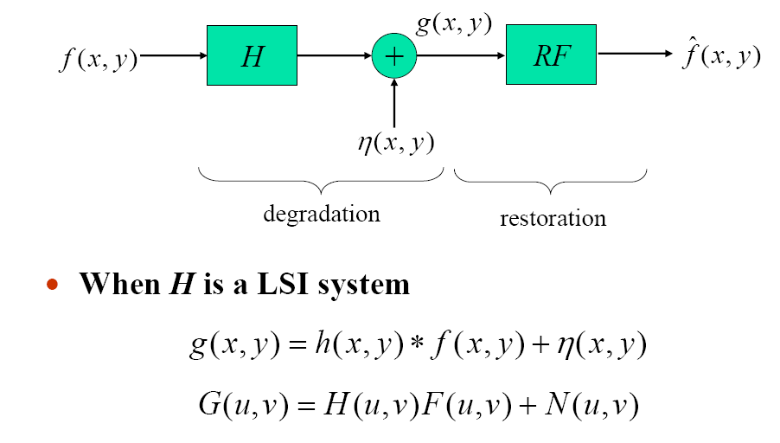
Image Degradation/Restoration Model
Defocus blur or motion blur
Sensor noise

Slide 6
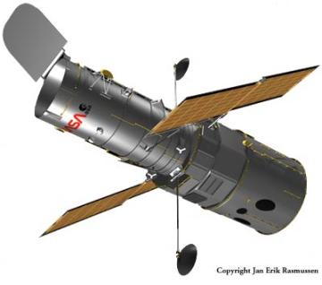
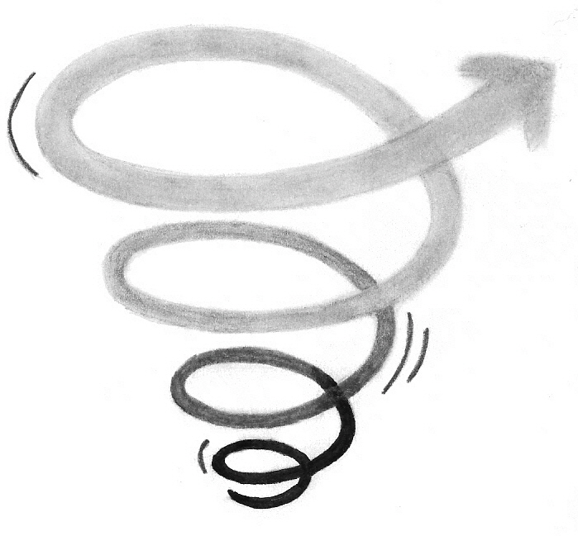
Noise and Images
The sources of noise in digital images arise during image acquisition (digitization) and transmission:
Noise from sensors
Electronic circuits
Light level
Sensor temperature
Noise from environment
Interference during Transmission
Lightening
Atmospheric disturbance
Other strong electric/magnetic signals

Slide 7
Noise Model
We can consider a noisy image to be modelled as follows:
where f(x, y) is the original image pixel, η(x, y) is the noise term and g(x, y) is the resulting noisy pixel
If we can estimate the model the noise in an image is based on this will help us to figure out how to restore the image

Slide 8
Noise probability density functions
Since noise in pixels is random so image noises are taken as random variables
Random variables have:
Probability density function (PDF)

Slide 9
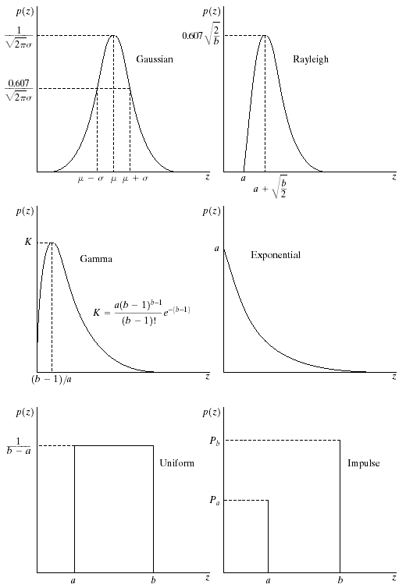
Famous Noise Models
There are many different models for the image noise term η(x, y):
Gaussian
Rayleigh
Erlang
Exponential
Uniform
Impulse: Salt and pepper noise
Gaussian
Rayleigh
Erlang
Exponential
Uniform
Impulse
Notes:
Gaussian Noise:
Gaussian noise, also known as white noise, follows a Gaussian (normal) distribution.
It is characterized by random variations that are symmetrically distributed around a mean value.
The noise values are typically small and can be positive or negative.
Rayleigh Noise:
Rayleigh noise follows a Rayleigh distribution, which is a skewed distribution often used to model the amplitudes of waves in wireless communication.
It is characterized by a single peak with a tail extending towards higher values.
Erlang Noise:
Erlang noise is modeled using the Erlang distribution, often used to represent the number of events occurring in a fixed interval of time or space.
It is characterized by a distribution that is a sum of exponential distributions.
Exponential Noise:
Exponential noise follows an exponential distribution and is often used to model random event occurrences over time.
It is characterized by a rapidly decreasing probability as the value increases.
Uniform Noise:
Uniform noise follows a uniform distribution and is characterized by a constant probability of occurrence for values within a defined range.
Noise values are equally likely within this range.
Impulse Noise:
Impulse noise is a type of noise that consists of occasional, sharp spikes or impulses.
It is often seen as sudden, short-lived, and extreme deviations from the expected values.
Salt and Pepper Noise:
Salt and pepper noise is a type of noise that introduces random, isolated high-intensity and low-intensity spikes in an image or signal.
The high-intensity spikes are often represented as "salt" (white pixels), while the low-intensity spikes are represented as "pepper" (black pixels).

Slide 10
Gaussian noise
Math. Tractability (convenience) in spatial and frequency domain
Electronic circuit noise and sensor noise follows Gaussian distribution i.e.,
mean
variance
Note:

Slide 11
Gaussian noise (PDF)
70% values of z fall in the range [(μ-σ),(μ+σ)]
95% values of z fall in the range [(μ-2σ),(μ+2σ)]

Slide 12
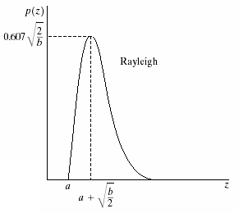
Rayleigh Noise
Rayleigh noise
The mean and variance of this density are given by
a and b can be obtained through mean and variance
Noise in MRI and sea bed images follows Rayleigh distribution

Slide 13
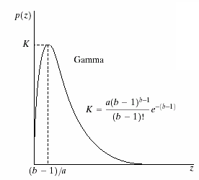
Erlang Noise
Erlang (Gamma) noise
The mean and variance of this density are given by
a and b can be obtained through mean and variance

Slide 14
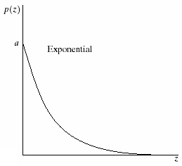
Exponential Noise
Exponential noise
The mean and variance of this density are given by
Special case pf Erlang PDF with b=1

Slide 15
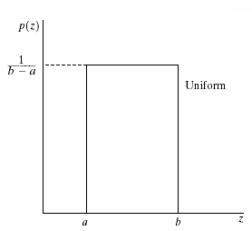
Uniform Noise
Uniform noise
The mean and variance of this density are given by
Used to Model Quantization noise in images

Slide 16
Impulse (salt-and-pepper) noise
Quick transients, such as faulty switching during imaging
If either P_{a} or P_{b} is zero, it is called unipolar.
Otherwise, it is called bipoloar.
In practice, impulses are usually stronger than image
signals. Ex., a=0(black) and b=255(white) in 8-bit image.

Slide 17
Impulse (salt-and-pepper) noise PDF

Slide 18
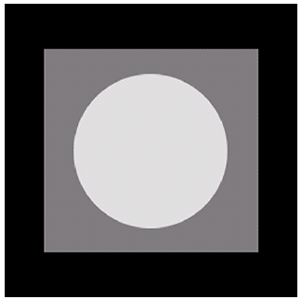
Noise Example
The test pattern to the right is ideal for demonstrating the addition of noise
The following slides will show the result of adding noise based on various models to this image
Image
Histogram to go here
Histogram

Slide 19
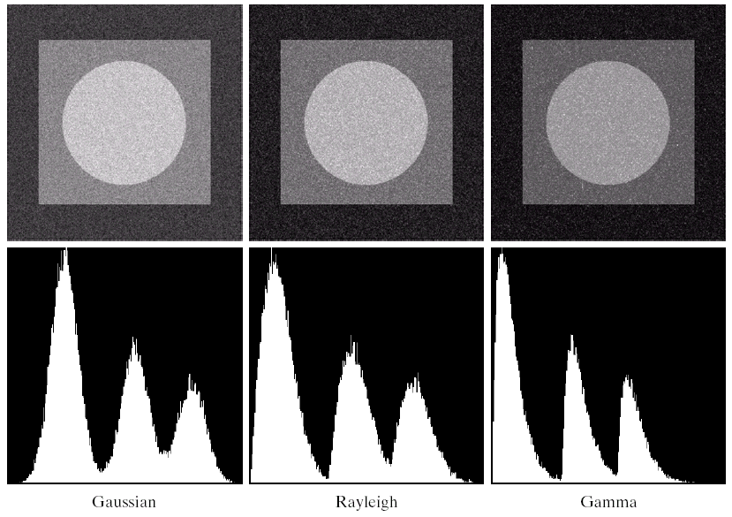
Noise Example (cont…)
Gaussian
Rayleigh
Erlang

Slide 20
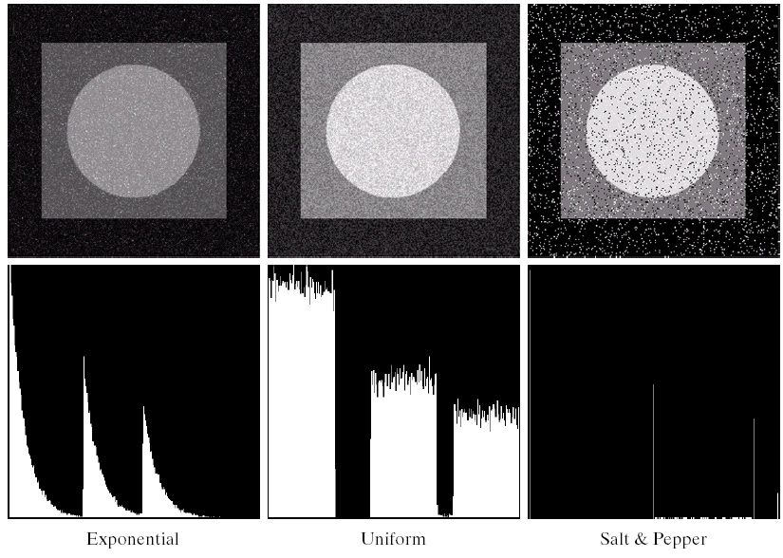
Noise Example (cont…)
Histogram to go here
Exponential
Uniform
Impulse

Slide 21
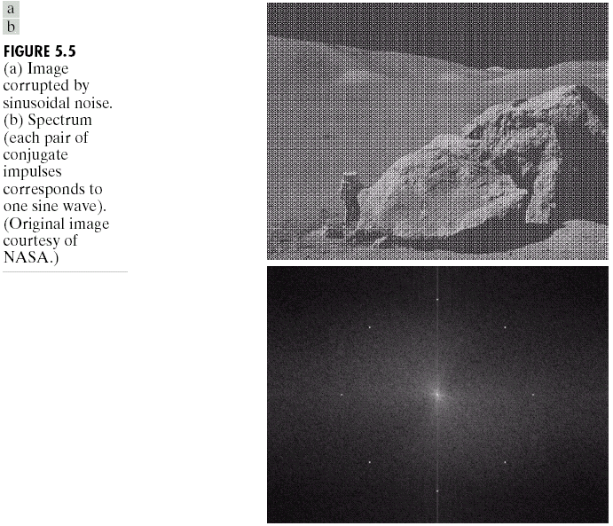
Periodic Noise
Arises typically from electrical or electromechanical interference during image acquisition
It can be observed by visual inspection both in the spatial domain and frequency domain
The only spatially dependent noise will be considered
Notes:
Electromechanical magnetic component interference

Slide 22
Estimation of Noise Parameters
Periodic noise
Parameters can be estimated by inspection of the spectrum
Noise PDFs (Probability Density Function)
From sensor specifications
If imaging sensors are available, capture a set of images of plain environments
If only noisy images are available, parameters of the PDF involved can be estimated from small patches of constant regions of the noisy images

Slide 23
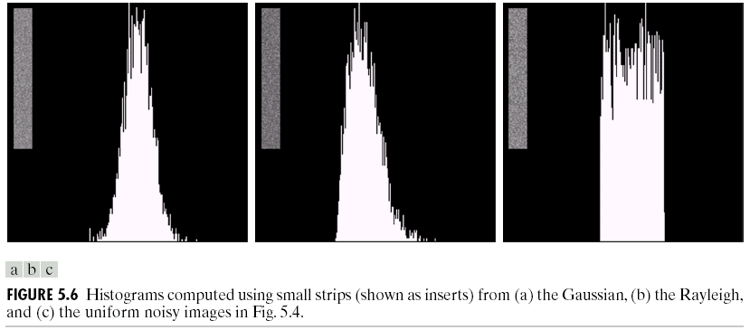
Estimation of Noise Parameters
In most cases, only mean and variance are to be estimated
Others can be obtained from the estimated mean and variance

Slide 24
Restoration by Spatial Filtering
We can use spatial filters of different kinds to remove different kinds of noise.
The arithmetic mean filter is a very simple one and is calculated as follows:
Blurs the image to remove noise.
Well suited for random noise like Gaussian or Uniform noise.

Slide 25
Other Means
There are different kinds of mean filters all of which exhibit slightly different behaviour:
Geometric Mean (better results than mean)
Harmonic Mean
Contraharmonic Mean

Slide 26
Other Means (cont…)
There are other variants of the mean which can give different performance
Geometric Mean:
Achieves similar smoothing to the arithmetic mean, but tends to lose less image detail hence results in sharper image. Also like mean filter well suited for random noise.
100 | 100 | 100
10 | 10 | 10
10 | 10 | 10
Example image
Notes:
Response using mean will be 40, while response using G. mean will be 22. Thus the value is more close to the centre location.

Slide 27
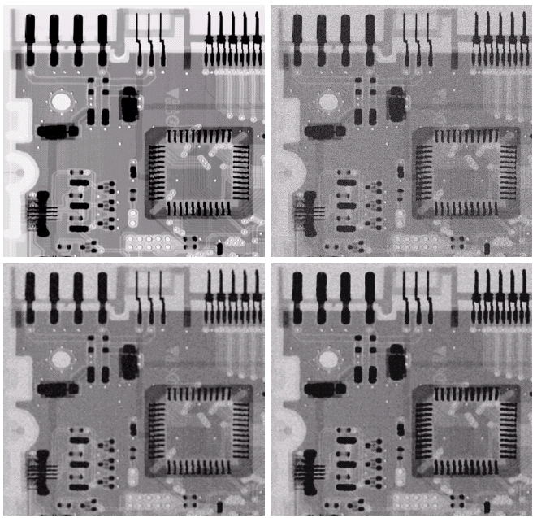
Noise Removal Examples
Image Corrupted By Gaussian Noise
Original Image
After A 3*3 Arithmetic Mean Filter
After A 3*3 Geometric Mean Filter

Slide 28
Other Means (cont…)
Harmonic Mean:
Works well for salt noise, but fails for pepper noise.
Also does well for other kinds of noise such as Gaussian noise.

Slide 29
Other Means (cont…)
Contraharmonic Mean:
Q is the order of the filter and adjusting its value changes the filter’s behaviour
Positive values of Q eliminate pepper noise
Negative values of Q eliminate salt noise

Slide 30
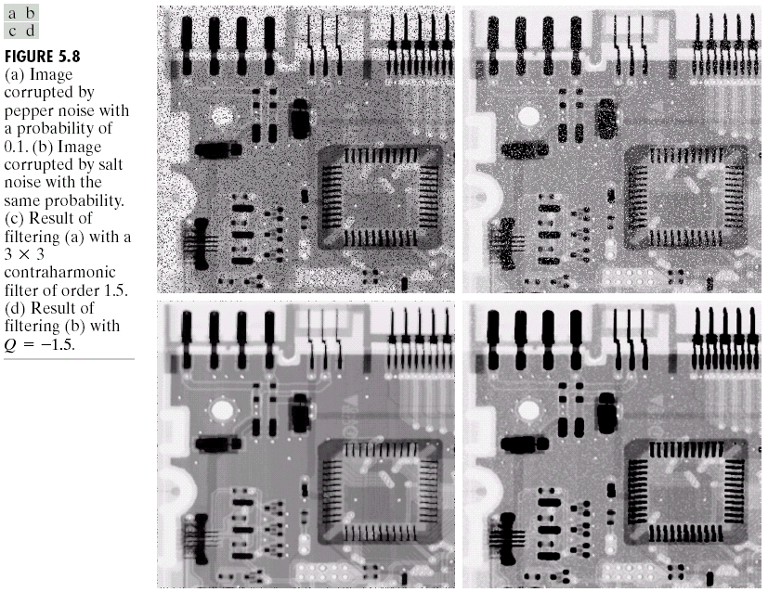
Noise Removal Examples (cont…)
Image Corrupted
By Pepper Noise
Result of Filtering Above With 3*3 Contraharmonic Q=1.5

Slide 31
Noise Removal Examples (cont…)
Image Corrupted
By Salt Noise
Result of Filtering Above With 3*3 Contraharmonic Q=-1.5

Slide 32
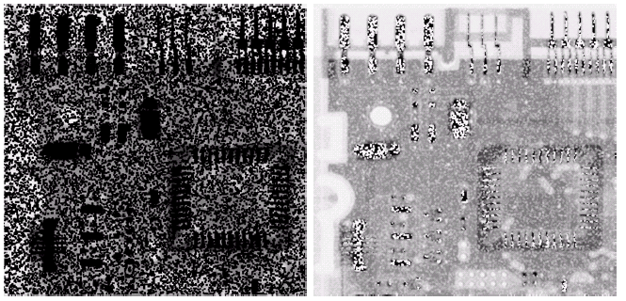
Contraharmonic Filter: Here Be Dragons
Choosing the wrong value for Q when using the contraharmonic filter can have drastic results
Negative value of Q
Positive value of Q

Slide 33
Order Statistics Filters
Spatial filters that are based on ordering the pixel values that make up the neighbourhood operated on by the filter
Useful spatial filters include
Median filter
Max and min filter
Midpoint filter
Alpha trimmed mean filter
Adaptive Filtering
We Prefer Sharp Images!!

Slide 34
Median Filter
Median Filter:
Excellent at noise removal, without the smoothing effects that can occur with other smoothing filters
Particularly good when salt and pepper noise is present

Slide 35
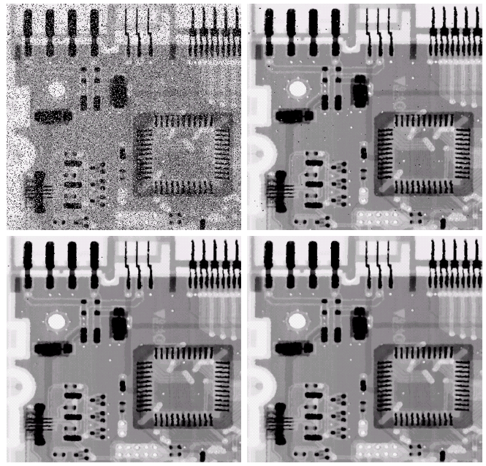
Noise Removal Examples
Image Corrupted By Salt And Pepper Noise
Result of 1 Pass With A 3*3 Median Filter
Result of 2 Passes With A 3*3 Median Filter
Result of 3 Passes With A 3*3 Median Filter

Slide 36
Max and Min Filter
Max Filter:
Min Filter:
Max filter is good for pepper noise and min is good for salt noise
Min & Max also do Dilation and Erosion respectively.

Slide 37
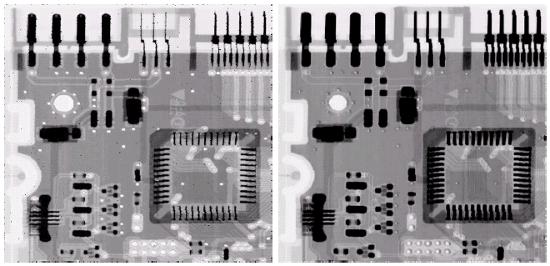
Noise Removal Examples (cont…)
Image Corrupted
By Pepper Noise
Image Corrupted
By Salt Noise
Result Of Filtering Above With A 3*3 Max Filter
Result Of Filtering Above With A 3*3 Min Filter

Slide 38
Midpoint Filter
Midpoint Filter:
Good for random Gaussian and uniform noise.
Tends to produce unwanted artifacts in the image.

Slide 39
Alpha-Trimmed Mean Filter
Alpha-Trimmed Mean Filter:
We can delete the d/2 lowest and d/2 highest grey levels
So g_{r}(s, t) represents the remaining mn – d pixels
Suitable for situations involving multiple types of noise, such as combination of Gaussian and Salt & Pepper noise.
With d=0, ATM Filter becomes Mean filter.
With d=mn-1, ATM Filter becomes Median filter.

Slide 40
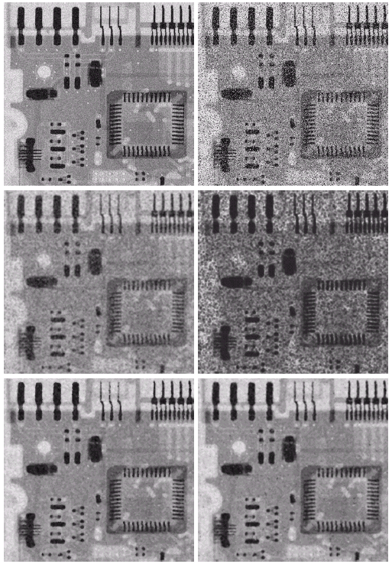
Noise Removal Examples (cont…)
Image Corrupted
By Uniform Noise
Image Further Corrupted
By Salt and Pepper Noise
Filtered By 5*5 Arithmetic Mean Filter
Filtered By 5*5 Geometric Mean Filter
Filtered By 5*5 Median Filter
Filtered By 5*5 Alpha-Trimmed Mean Filter

Slide 41
Adaptive Filters - (intelligent!)
The filters discussed so far are applied to an entire image without any regard for how image characteristics vary from one point to another.
The behaviour of adaptive filters changes depending on the characteristics of the image inside the filter region.
We will take a look at the adaptive median filter.

Slide 42
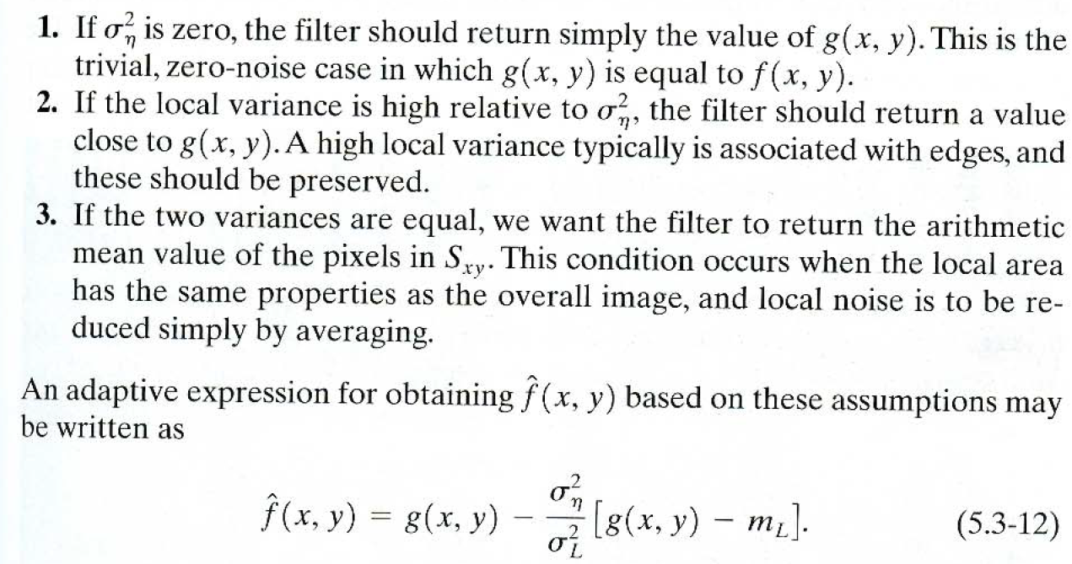
Adaptive Local Noise Reduction Filter

Slide 43
Adaptive Median Filtering
The median filter performs relatively well on impulse noise as long as the spatial density of the impulse noise is not large (i.e., p<0.20)
The adaptive median filter can handle much more spatially dense impulse noise, and also performs some smoothing for non-impulse noise.
The key insight in the adaptive median filter is that the filter size changes depending on the characteristics of the image.

Slide 44
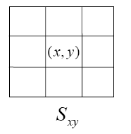
Adaptive Median Filtering (cont…)
Remember that filtering looks at each original pixel image in turn and generates a new filtered pixel
First examine the following notation:
z_{min} = minimum grey level in S_{xy}
z_{max} = maximum grey level in S_{xy}
z_{med} = median of grey levels in S_{xy}
z_{xy} = grey level at coordinates (x, y)
S_{max} =maximum allowed size of S_{xy}

Slide 45
Adaptive Median Filtering (cont…)
z_{med} is not impulse noise, since: z_{min} < z_{med} < z_{max}
Level A: A1 = z_{med} – z_{min}
A2 = z_{med} – z_{max}
If A1 > 0 and A2 < 0, Go to level B
Else increase the window size
If window size ≤ S_{max} repeat level A
Else output z_{med}
Level B: B1 = z_{xy} – z_{min}
B2 = z_{xy} – z_{max}
If B1 > 0 and B2 < 0, output z_{xy}
Else output z_{med}
z_{xy} is not impulse noise, since: z_{min} < z_{xy} < z_{max}

Slide 46
Adaptive Median Filtering (cont…)
The key to understanding the algorithm is to remember that the adaptive median filter has three purposes:
Remove impulse noise
Provide smoothing of other noise
Reduce distortion (excessive thining or thickening of object boundaries).

Slide 47
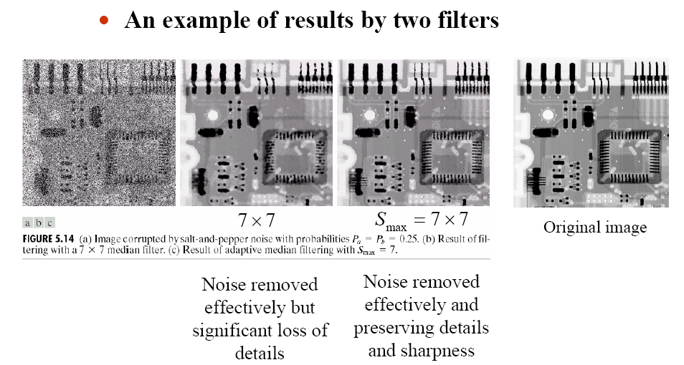
Adaptive Filtering Example

Slide 48
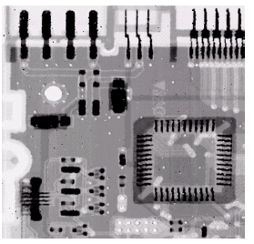

Slide 49
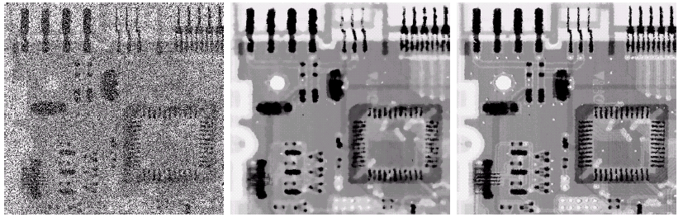
Adaptive Filtering Example
Image corrupted by salt and pepper noise with probabilities P_{a} = P_{b}=0.25
Result of filtering with a 7 * 7 median filter
Result of adaptive median filtering with i = 7

Slide 50
Periodic Noise
Typically arises due to electrical or electromagnetic interference
Gives rise to regular noise patterns in an image
Frequency domain techniques in the Fourier domain are most effective at removing periodic noise

Slide 51
Band Reject Filters
Removing periodic noise form an image involves removing a particular range of frequencies from that image
Band reject filters can be used for this purpose
An ideal band reject filter is given as follows:

Slide 52
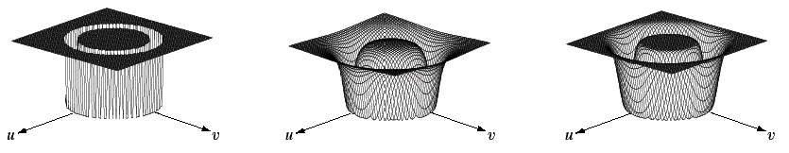
Band Reject Filters (cont…)
The ideal band reject filter is shown below, along with Butterworth and Gaussian versions of the filter
Ideal Band Reject Filter
Butterworth Band Reject Filter (of order 1)
Gaussian Band Reject Filter

Slide 53
Band Reject Filter Example
Image corrupted by sinusoidal noise
Fourier spectrum of corrupted image
Butterworth band reject filter
Filtered image

